Slide 1
Structuring Requirements
Data Modeling w/Entity Relationship Diagrams

Slide 2
Different Models
Each of the models (in Systems Analysis and Design) communicates different information about the system (business process)
Each model plays a role in the development of solution to a business problem
To meet the operational feasibility

Slide 3
Approaches to Systems Development
Process-Oriented Approach
Focus is on flow, use and transformation of data in an information system
Involves creating graphical representations such as data flow diagrams and charts

Slide 4
Approaches to Systems Development
Process-Oriented Approach
Data are tracked from sources, through intermediate steps and to final destinations
Natural structure of data is not specified
Disadvantage: data files are tied to specific applications

Slide 5
Approaches to Systems Development
Data-Oriented Approach
Depicts ideal organization of data, independent of where and how data are used
Data model describes kinds of data and business relationships among the data
Business rules depict how organization captures and processes the data

Slide 6
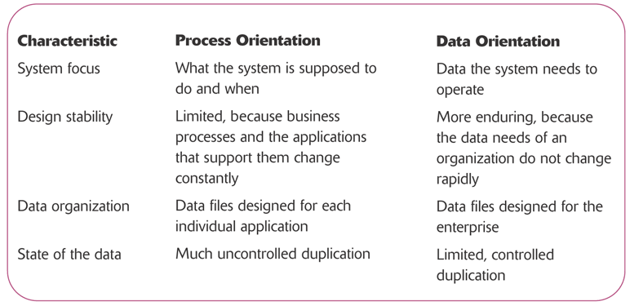
Compare & Contrast

Slide 7
Where are We?
Database
Systems Analysis & Design
Introduction
Systems
Planning
& Selection
Systems
Analysis
Systems
Design
Systems
Implementation
Requirements
Gathering
Use Cases
Data
Modeling
Process
Modeling

Slide 8
Objectives
Define data modeling and explain its benefits.
Recognize and understand the basic concepts and constructs of a data model.
Read and interpret an entity relationship data model.
Discover entities and relationships.
Construct an entity-relationship diagram.
Discover or invent keys for entities
Notes:
No additional notes

Slide 9
Data Modeling
Data modeling – a technique for organizing and documenting a system’s data. A method for the representation of organizational data.
Sometimes called database modeling.
Entity relationship diagram (ERD) – a data model utilizing several notations to depict data in terms of the entities and relationships described by that data.
Notes:
No additional notes

Slide 10
Process of Conceptual Data Modeling
First step is to develop a data model for the system being replaced (As-Is)
Next, a new conceptual data model is built that includes all the requirements of the new system (To-Be)
In the design stage, the conceptual data model is translated into a physical design
Database Schema

Slide 11
Entity-Relationship Diagram
The primary purpose of the entity-relationship diagram is to model the entities in the business environment, the relationships or associations among the entities, and the attributes or properties of both the entities and their relationships

Slide 12
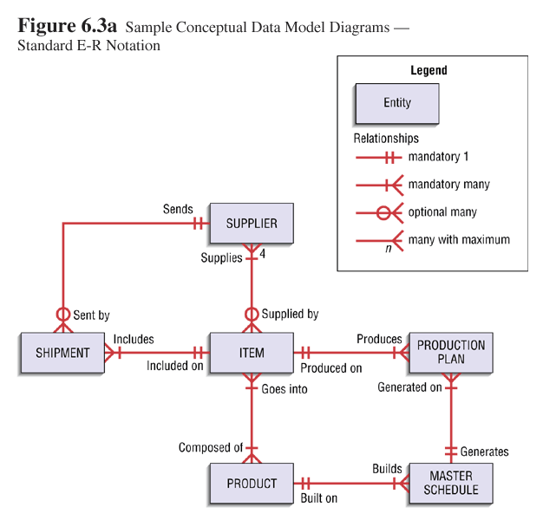
Example—ERD Notation

Slide 13

Data Modeling Concepts: Entity
Entity – a class of persons, places, objects, events, or concepts about which we need to capture and store data.
Named by a singular noun
Persons: agency, contractor, customer, department, division, employee, instructor, student, supplier.
Places: sales region, building, room, branch office, campus.
Objects: book, machine, part, product, raw material, software license, software package, tool, vehicle model, vehicle.
Events: application, award, cancellation, class, flight, invoice, order, registration, renewal, requisition, reservation, sale, trip.
Concepts: account, block of time, bond, course, fund, qualification, stock.
Notes:
Teaching Notes:
Prompt the students for additional examples. Have them classify their example(s).
Obtain a data model from a source other than the textbook. Ask the students to classify the entities.

Slide 14
Data Modeling Concepts: Entity
Entity instance – a single occurrence of an entity.
entity
Student ID | Last Name | First Name
2144 | Arnold | Betty
3122 | Taylor | John
3843 | Simmons | Lisa
9844 | Macy | Bill
2837 | Leath | Heather
2293 | Wrench | Tim
instances
Notes:
Teaching Notes
Substitute the name(s) of one or more of your students.
Be sure to explain that these are “instances” and that instances do NOT appear in the names of entity symbols.

Slide 15
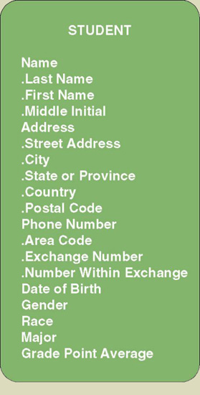
Data Modeling Concepts: Attributes
Attribute – a descriptive property or characteristic of an entity. Synonyms include element, property, and field.
Just as a physical student can have attributes, such as hair color, height, etc., data entity has data attributes
Notes:
Teaching Notes:
Go back to the slide showing the sample ERD (Figure 7-1). Pick an entity and ask the students to list attributes that they feel describe those entities.
Show the students a form. Ask the students to identify the attributes. Be sure that the students recognize what items appearing on the form are truly attributes and those that are simply headings or preprinted items. Also, often students accidentally identify attribute values as attributes. For example, they may say that an item that appears as a check box is an attribute when in fact it may be the value of an attribute (ie. Male and female are values, whereas GENDER is the real attribute).

Slide 16
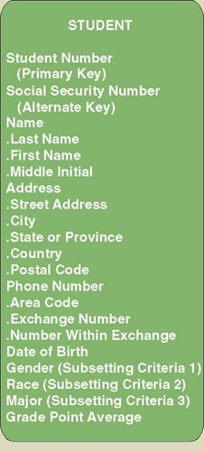
Data Modeling Concepts: Identification
Key – an attribute, or a group of attributes, that assumes a unique value for each entity instance. It is sometimes called an identifier.
Candidate key – one of a number of keys that may serve as the primary key. Synonym: candidate identifier.
Primary key – a candidate key used to uniquely identify a single entity instance.
Notes:
Teaching Notes
Students can generally relate to the following example. Suppose you are working for an hourly wage. The employer has some method of tracking the hours you work. Whether that involves a time clock, an identification badge that it scanned, or a log book, the system records a certain number of hours and some employee identifier that says those hours are yours. Without that identifier, come pay day the employer would not know whose hours were whose. The employer might pay someone else for the hours you worked. That’s how important a primary key or identifier is.

Slide 17
Data Modeling Concepts: Relationships
Relationship – a natural business association that exists between one or more entities.
Named by a verb or verb phrase
The relationship may represent an event that links the entities or merely a logical affinity that exists between the entities.
Notes:
Teaching Notes
Explain that there may be more than one relationship between two entities. You may reinforce this by adding additional relationships to the example (such as “transferred from” (to reflect a relationship where students changed from one curriculum to another).

Slide 18
Data Modeling Concepts: Cardinality
Cardinality – the minimum and maximum number of occurrences of one entity that may be related to a single occurrence of the other entity.
Because all relationships are bidirectional, cardinality must be defined in both directions for every relationship.
bidirectional
Notes:
Teaching Notes
Ask the students to read (or write) declarative sentences to reflect the bidirectional meaning of the relationship between student and curriculum.

Slide 19
Data Modeling Concepts: Foreign Keys
Foreign key – a primary key of an entity that is used in another entity to identify instances of a relationship.
A foreign key is a primary key of one entity that is contributed to (duplicated in) another entity to identify instances of a relationship.
A foreign key always matches the primary key in the another entity
A foreign key may or may not be unique (generally not)
The entity with the foreign key is called the child.
The entity with the matching primary key is called the parent.
Notes:
Teaching Notes
Foreign keys are what make a relational database relational.

Slide 20
Process of Logical Data Modeling
Strategic Data Modeling
Many organizations select IS development projects based on strategic plans.
Includes vision and architecture for information systems
Identifies and prioritizes develop projects
Includes enterprise data model as starting point for projects
Data Modeling during Systems Analysis
Data model for a single information system is called an application data model.
Notes:
Teaching Notes
Data modeling may be performed during various types of projects and in multiple phases of projects.
Data models are progressive and should be considered a living document that will change in response to changing business needs.

Slide 21
Gathering Information for Conceptual Data Modeling
Two perspectives
Top-down
Data model is derived from an intimate understanding of the business
Set of seven different categories of questions
Bottom-up
Data model is derived by reviewing specifications and business documents

Slide 22
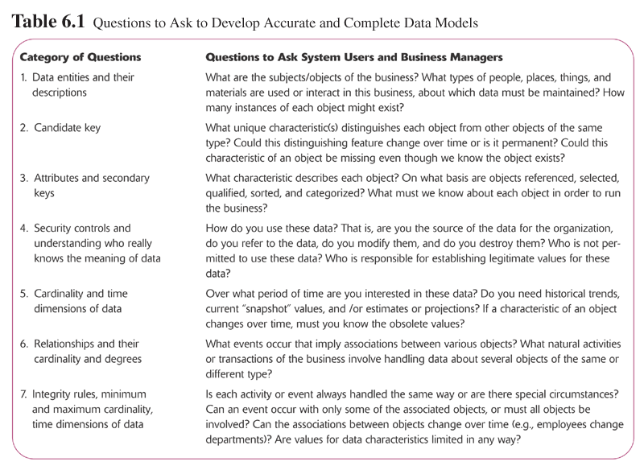
Questions Asked

Slide 23
Entity Discovery
In interviews, pay attention to key words (i.e. "we need to keep track of ...").
In interviews, ask users to identify things about which they would like to capture, store, and produce information.
Study existing forms, files, and reports.
Scan use use case narratives for nouns.
Notes:
No additional notes.

Slide 24
Four Steps in ERD Creation
Identify Entities
Define Attributes
Identify the primary key
Identify (Business) Relationships
Define Cardinality
Either 1-1, 1-many, or many-many

Slide 25
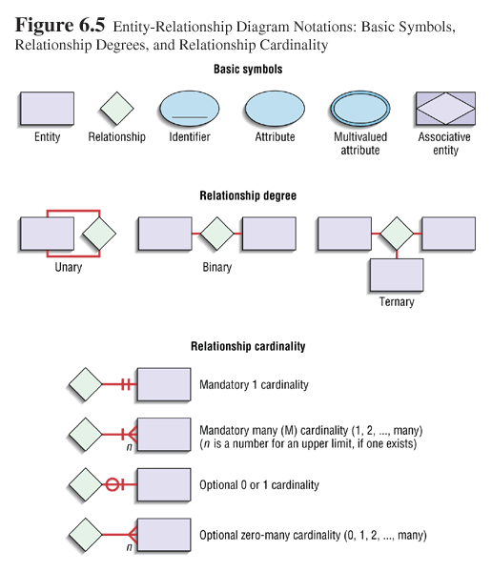
Entity-Relationship (E-R) Modeling Notation

Slide 26
Creating an ERD— Spring Breaks R’ Us
Spring Breaks R’ Us Travel Service (SBRU) books spring-break trips at resorts for college students. During the fall semester, resorts submit availability information to SBRU indicating rooms, room capacity, and room rates for each week of the spring-break season. Each resort offers bookings for a different number of weeks each season, and rooms have different rates depending on the week. Usually the resorts make a variety of rooms with different capabilities available so students can book the right size room. Couples can book a two-person room, for example, and four people can book a room for four.
In December, SBRU generates a list of resorts, available weeks, and room rates that is distributed to college campus representatives all over the country. When a group of students submits a reservation request for a week at a particular resort, SBRU assigns the students to a room with sufficient capacity and sends each student a confirmation notice. When the cutoff date for a week arrives, SBRU sends each resort a list of students booked for each room the following week. When the students arrive at the resort, they pay the resort directly for the room. Resorts send commission checks directly to the SBRU accounting system, which is separate from the booking system. When spring break is over, students return to their schools and hit the books.

